Slide 1
Model checking in the BMA
Ben Hall, UCL

Slide 2
Introduction
Model checking for biology
Why
How
Proof tools in BMA
Stability
LTL
Applications of model checking

Slide 3
Robustness and rare events
Biological systems are frequently characterised by robustness
Homeostasis and equilibrium dominate cellular and biochemical systems
Robustness underlines cellular function
Diseases are often associated with rare events
Cancer is an exemplar of rare failure
The wrong mutations occurring in exactly the wrong order
1 in 70 trillion cells develop into cancer, over a lifetime
How to capture rare events? How to guarantee they don’t exist?

Slide 4
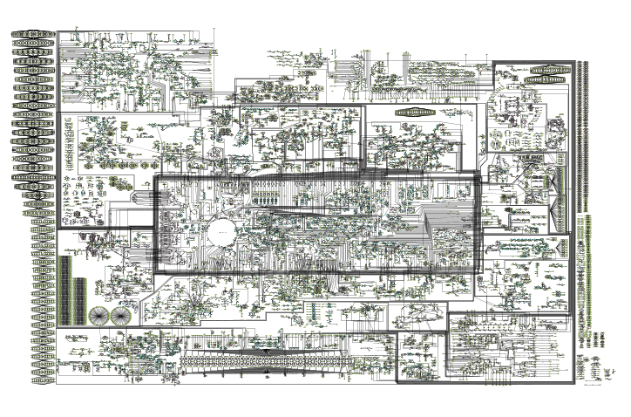
Cellular metabolism

Slide 5
Biocomplexity
As systems become more complex, the space for rare events increases
The implications of uncertainties are magnified in large systems
Models become larger → increased potential for error
Models become larger → harder to explore

Slide 6
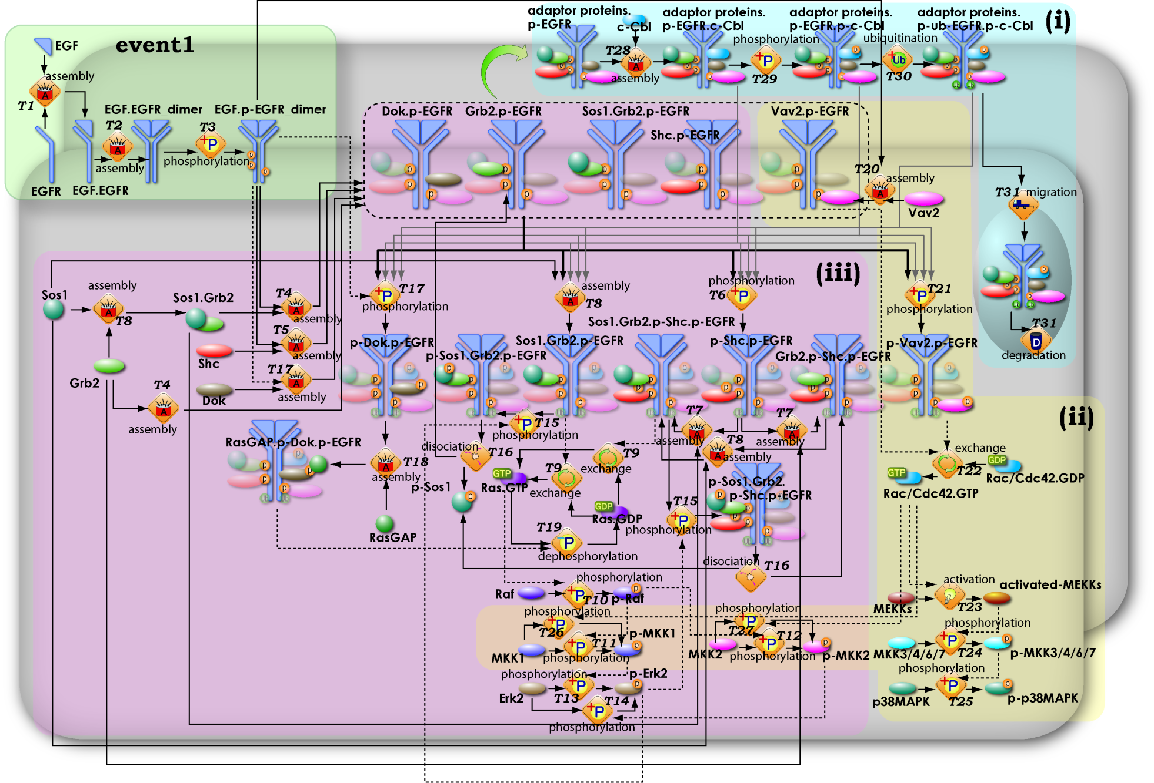
EGFR signalling pathway

Slide 7
Model checking = guarantees
Model checking addresses all of state space through mathematical proofs
This give us guarantees
This can happen (rare events)
This never happens (robustness)
Model checking can solve problems for both the issues, and problems that exist at their intersection

Slide 9
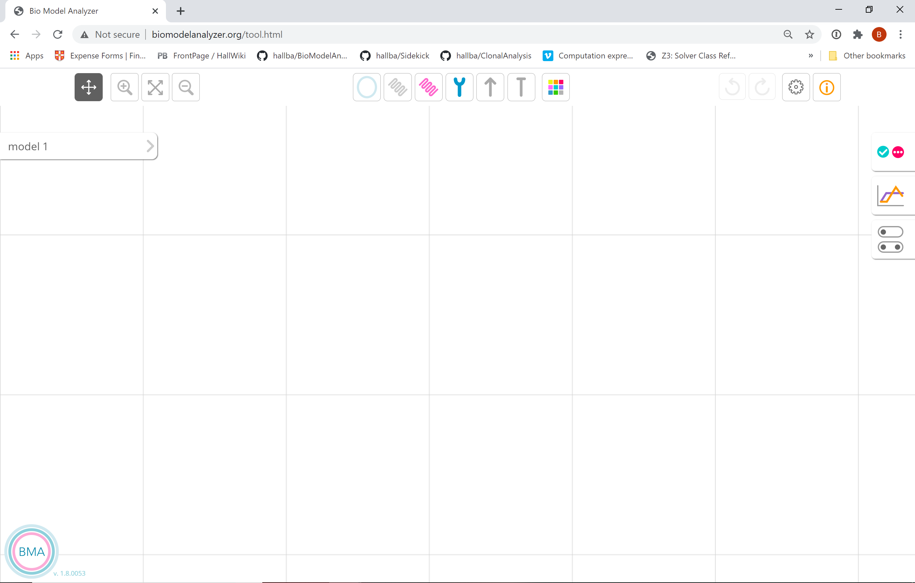
BioModelAnalyzer (BMA)

Slide 10
BMA
Open source (MIT)
https://github.com/hallba/BioModelAnalyzer
Web tool
http://biomodelanalyzer.org/
Standalone binaries
Local webserver
Console

Slide 14
Model checking in the BMA
Stability
Homeostasis or equilibrium
Bifurcations, oscillations
Linear temporal logic
“Simulation search”

Slide 15
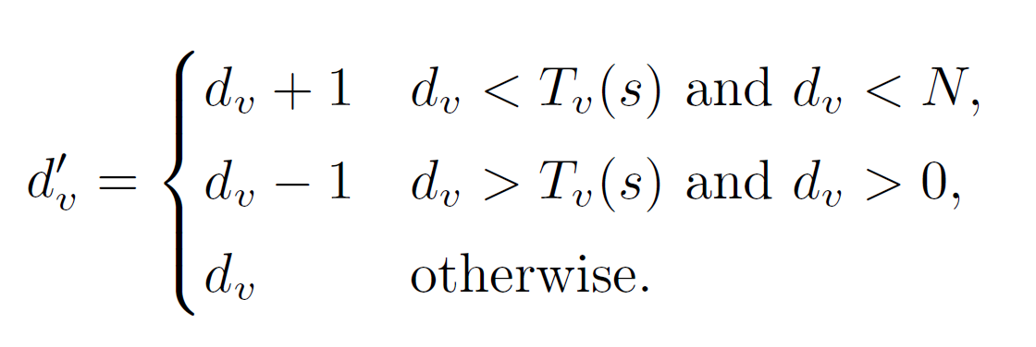
QN fundamentals
Models are synchronous qualitative networks
Each variable has a granularity and target function, describing how the variable updates

Slide 16
Stability proof
“Does the model have a single fix point attractor”
Alternatives- multiple fix points or a cycle
Common method- compute state transition graph
BMA approach; prove the stability of the system by iteratively proving the stability of individual variables, by reducing their range
Cook et al, VMCAI 2011

Slide 17
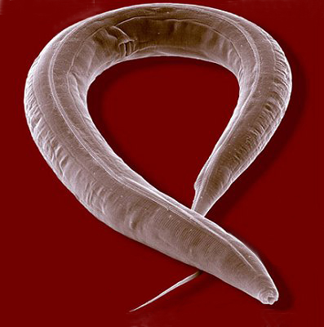
Stability in biological systems
In the organ development, cells commit to a cell fate that determines the structure of the organ
These fate patterns are invariant in wild-type
Stable
Some mutations may lead to variable fate patterns
Unstable

Slide 18
Cell fate in organogenesis
Wild type- stable
lin15(o) – unstable, fix points
AC
AC
1º
1º
2º
1º
2º
1º
AC
3º
3º
2º
1º
2º
3º
2º
1º
2º
1º
2º
1º
AC
1º
2º
2º
1º
2º
1º
Hall et al, Royal Society Interface 2014

Slide 19
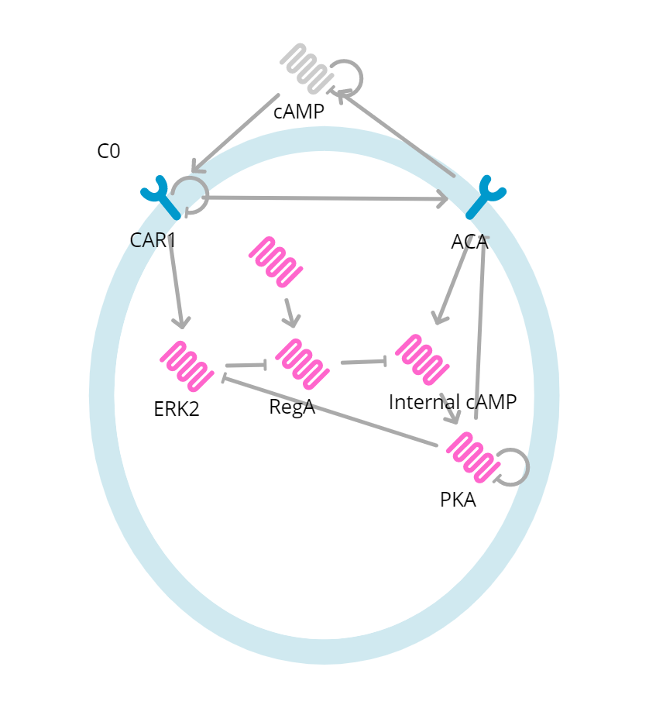
Cycles in cell fate
Dicty is single cell when in a fed state, with low cAMP production
Fixpoint/steady state
In response to starvation, it generates waves of cAMP that trigger development
Cycle
Hall and Fisher, Current Protocols in Bioinformatics, 2020

Slide 20
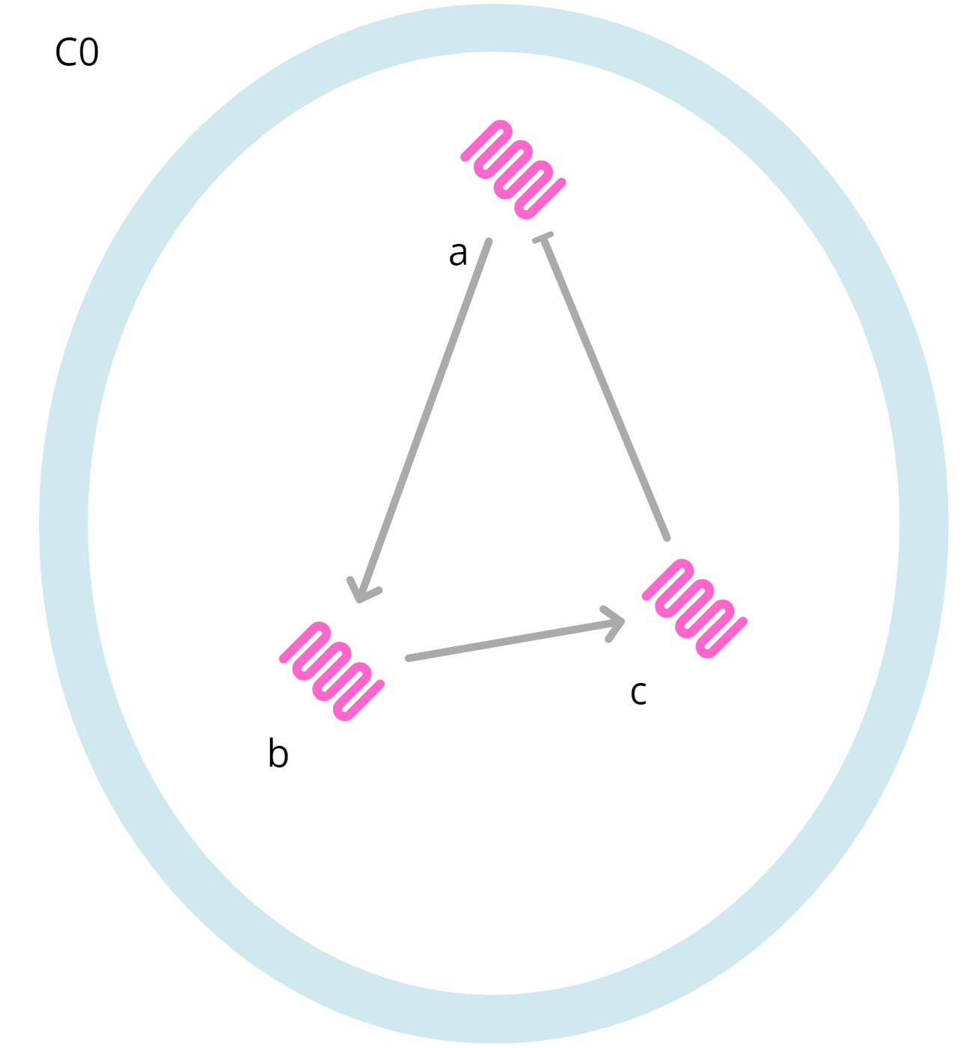
Example (ToyModelStable)
Variables have default target function
All range from zero to four

Slide 21
Process
At each step
Pick a variable
From the ranges of its dependents, attempt to reduce the range
Iterate until either all ranges are a singleton, or ranges cannot be reduced further

Slide 22
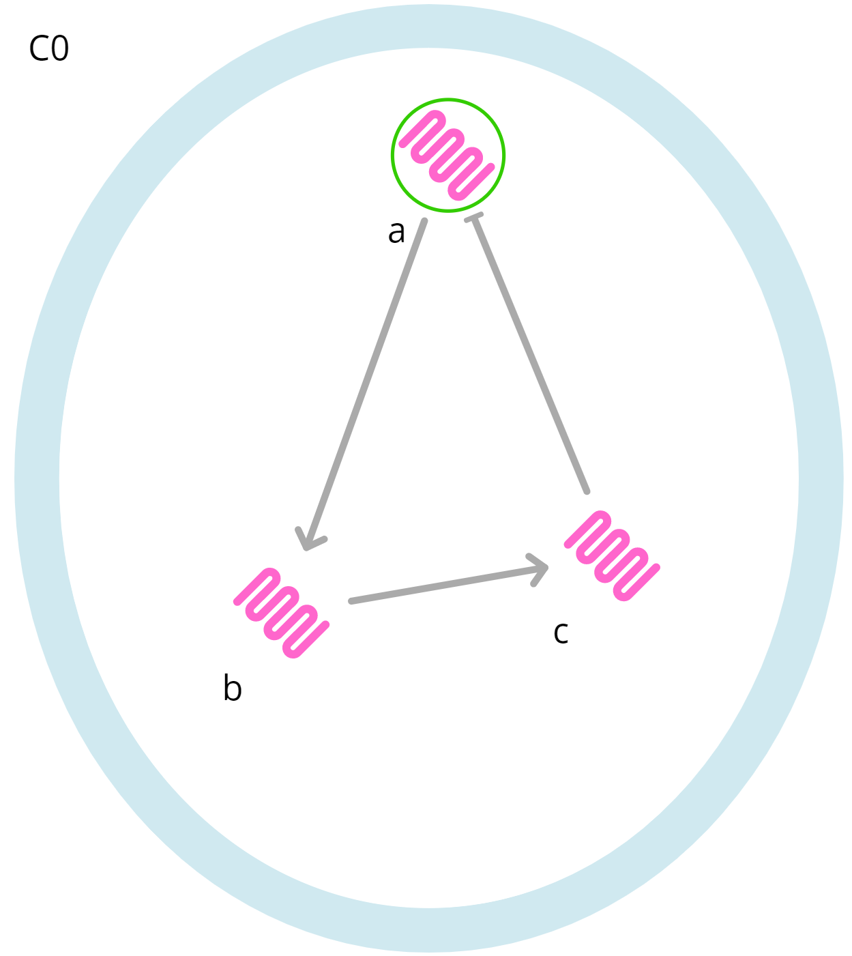
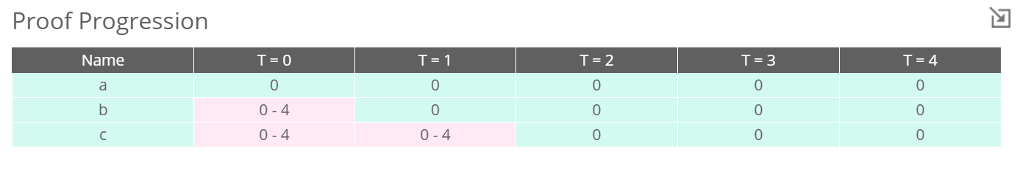
a
a ranges from 0-4
T(a) = 0 – c
c ranges from 0-4
So
a can only be equal to 0

Slide 23
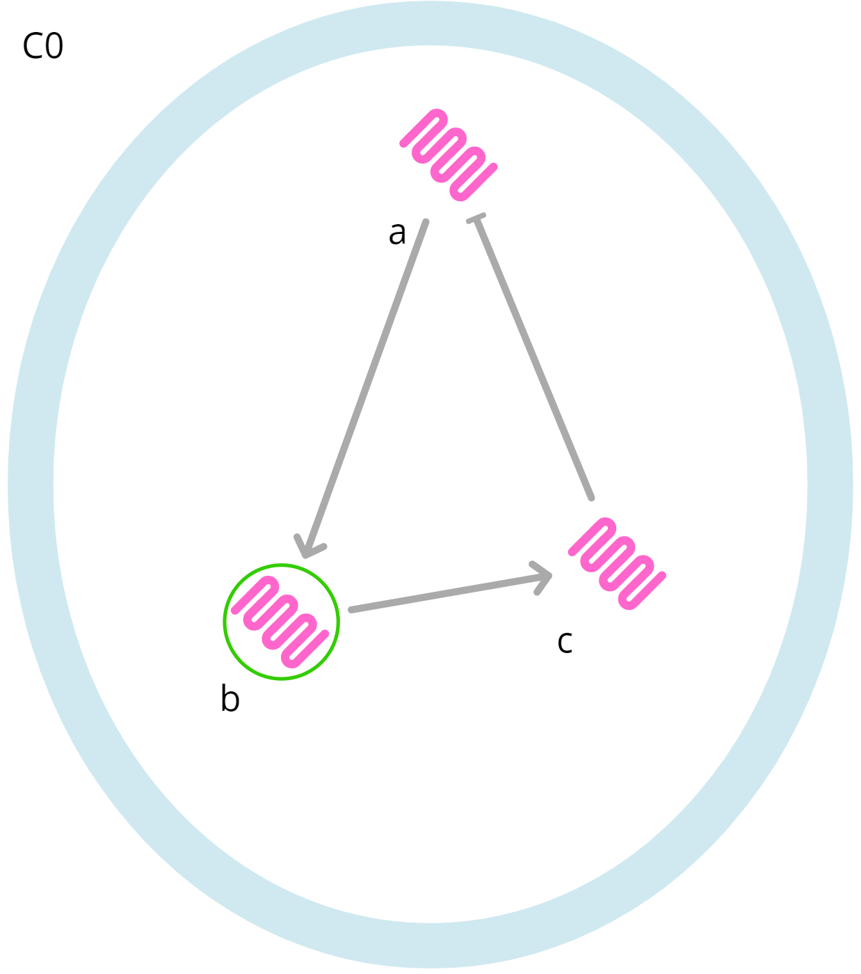
b
b ranges from 0-4
T(b) = a
a = 0 (previous step)
So
b can only be equal to 0

Slide 24
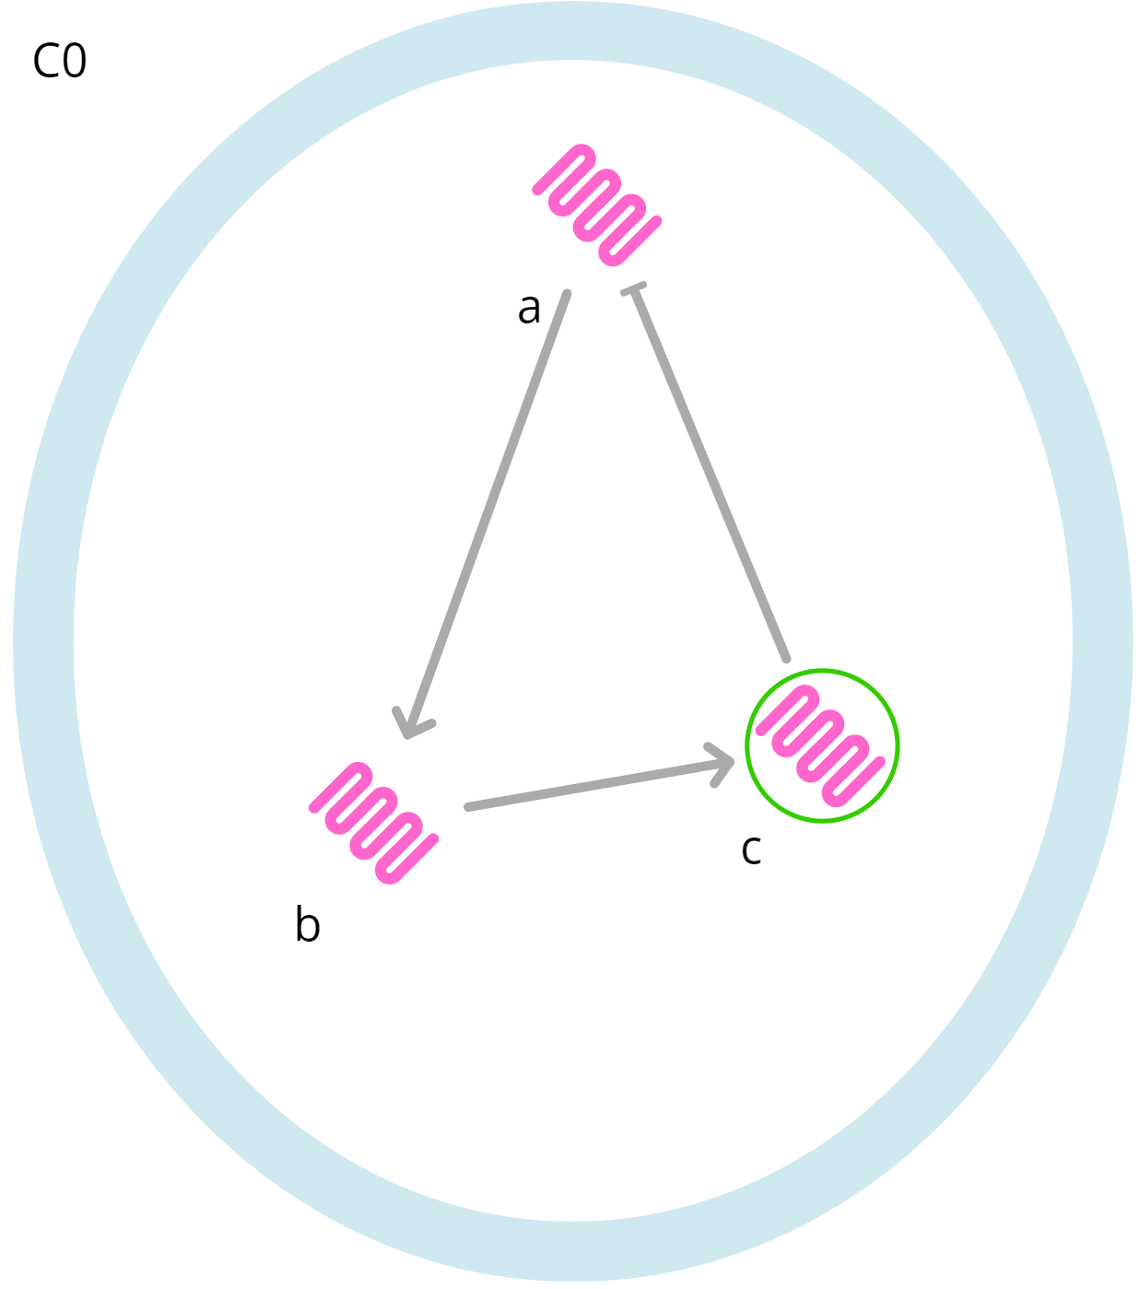
c ranges from 0-4
T(c) = b
b = 0
So
c can only be equal to 0

Slide 25
What if its not proved stable?
Does not imply instability
In the tool, “further testing” runs a second test to determine what the endpoints are
This is assessed by using the reduced ranges from the first step and a Z3 query to search for fixpoints and cycles (covered in practical)

Slide 26
Z3 – what and why?
Practical introduction
Key features
Speed
“no algorithms” = Get what you ask for

Slide 27
Z3 Theorem Prover (SMT)
Define named variables in a range of types- Bool, Int, Float and others
Define logical relationships that determine the variable states
From a set of assertions that link variables either returns “sat” or “unsat”
There is a set of variable assignments (“model”) or there isn’t

Slide 28
Simple example
Define a variable
mkConstInt(A)
Add a constraint to the solver
MkEqual(A,0)
Check
Sat
A = 0

Slide 29
Qualitative network (variable)
Define a single Z3 variable to represent a variable in the model, at a single time
mkConstInt(A^0)
Restrict the variable to its range
MkLt(A^0,N)
MkGe(A^0,0)

Slide 30
Qualitative network (update)
Define a second variable as before
mkConstInt(A^1)
Define how it updates
Calculate the target function from its dependents
Define the value of the second variable in terms of the target function and the state (T)
mkImplies(mkEq(T,A^0),mkEq(A^0,A^1))
mkImplies(mkGt(T,A^0),mkEq(A^0+1,A^1))…

Slide 31
How does this work for searching for states?
All variables of the model at a single point in time
The relationships between two times (i.e. update)

Slide 32
Bifurcation

Slide 33
Cycle

Slide 34
Stable

Slide 35
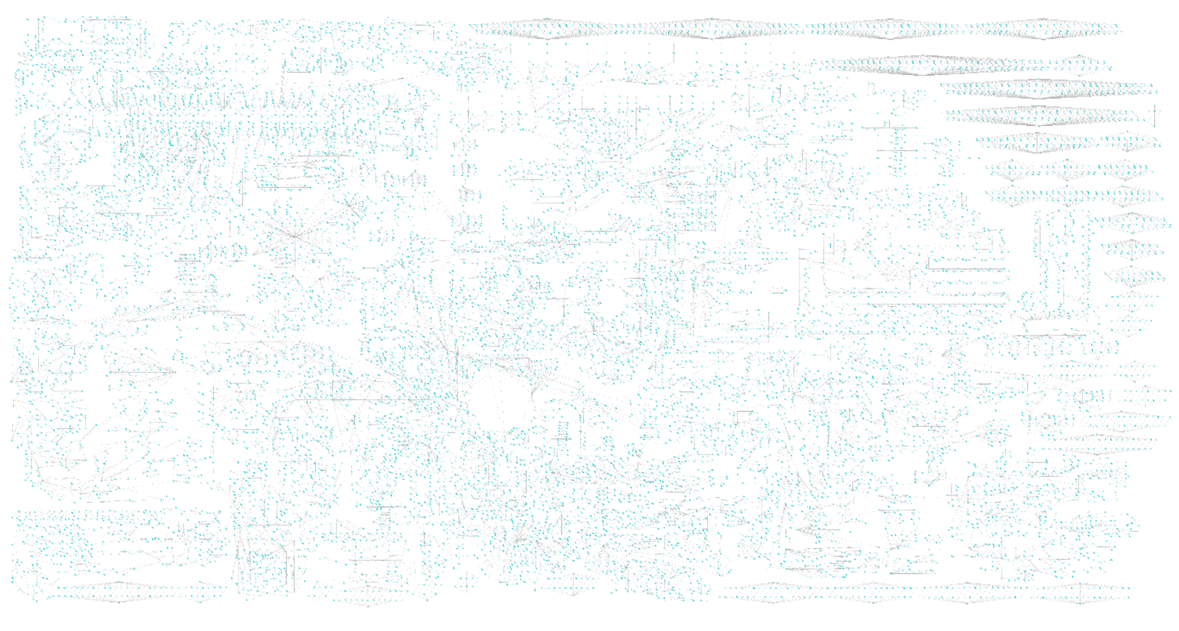
Scalability
~2^17000

Slide 36
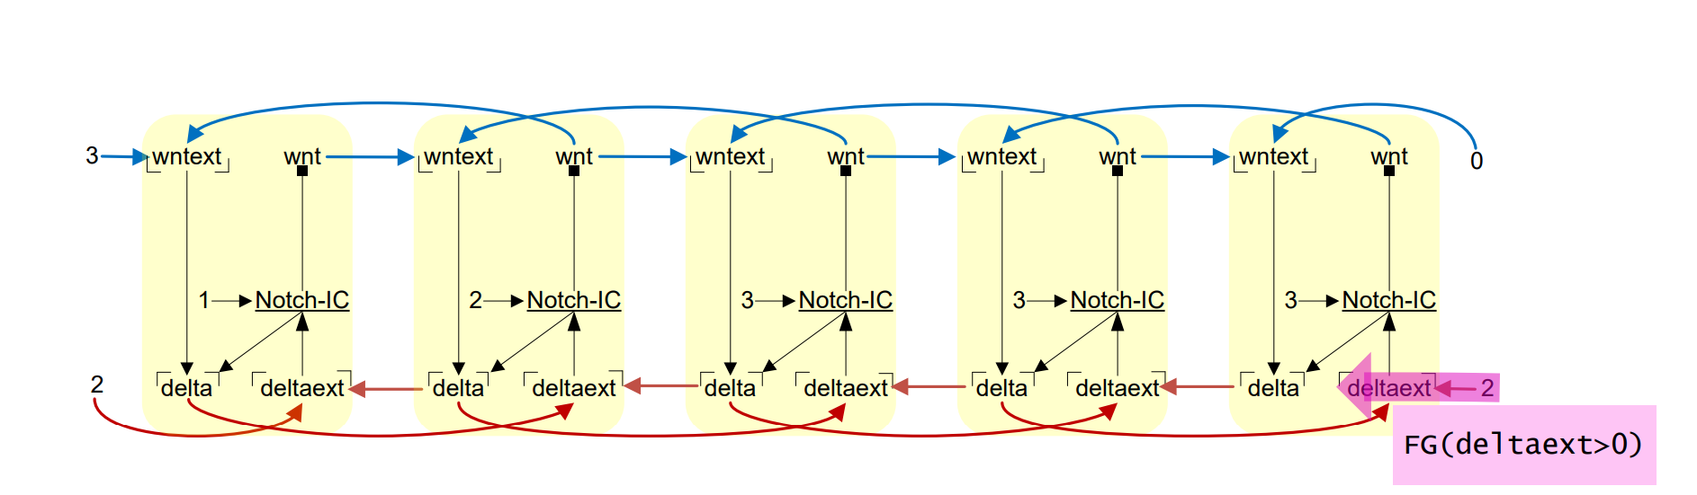
Scalability
~5^5000

Slide 37
Linear Temporal Logic
LTL allows users to “search” for simulations
“Does this gene ever transiently become active?”
“If this mutation is present, do cells ever become senescent?”
Query and simulation length as inputs
Returns example simulations
In BMA; three responses are generated from a single query
This is true for all simulations (always)
This is true for some simulations (sometimes)
This is false for all simulations (never)
Claessen et al, CAV 2013

Slide 38
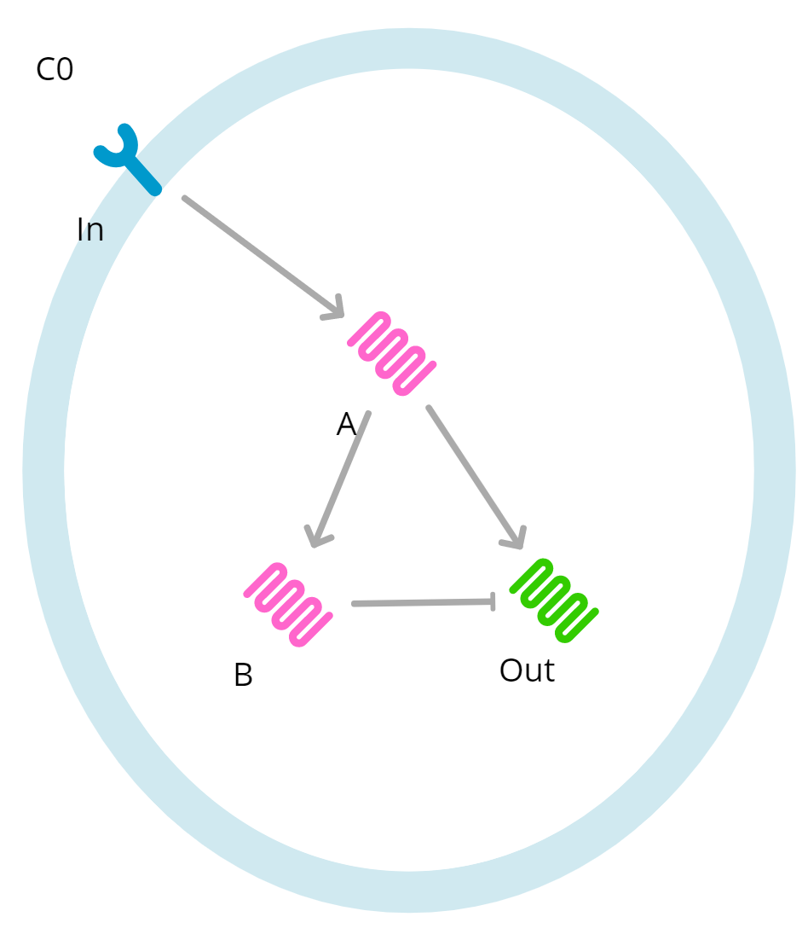
Example- negative feedforward loop
Boolean network with default functions except In, which is set to constant 1 or 0
Out always eventually becomes 0 regardless of In
Out can become 1 transiently if In is high and other components are 0

Slide 39
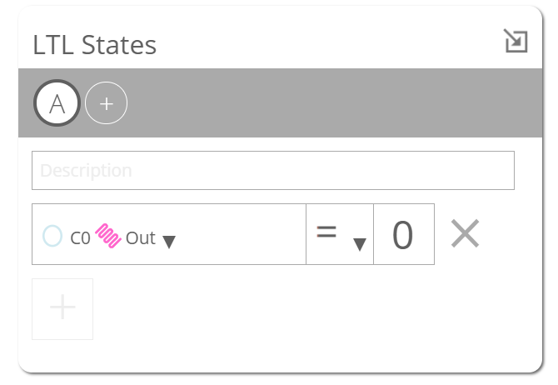
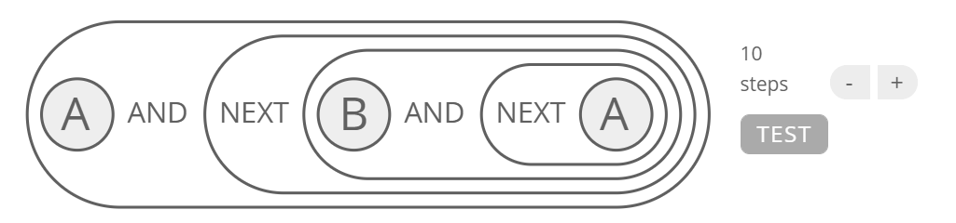
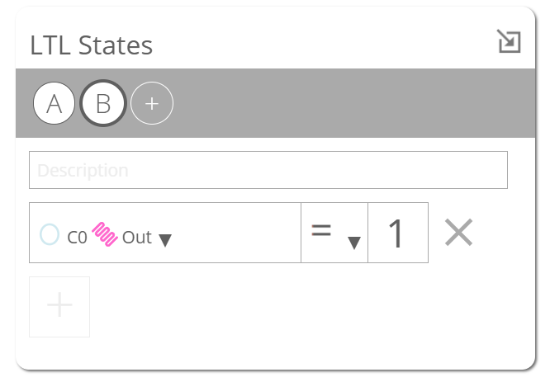
Testing for transient activation
States describe the value of variables at points in time
Temporal operators and logical describe the relationship between states

Slide 40
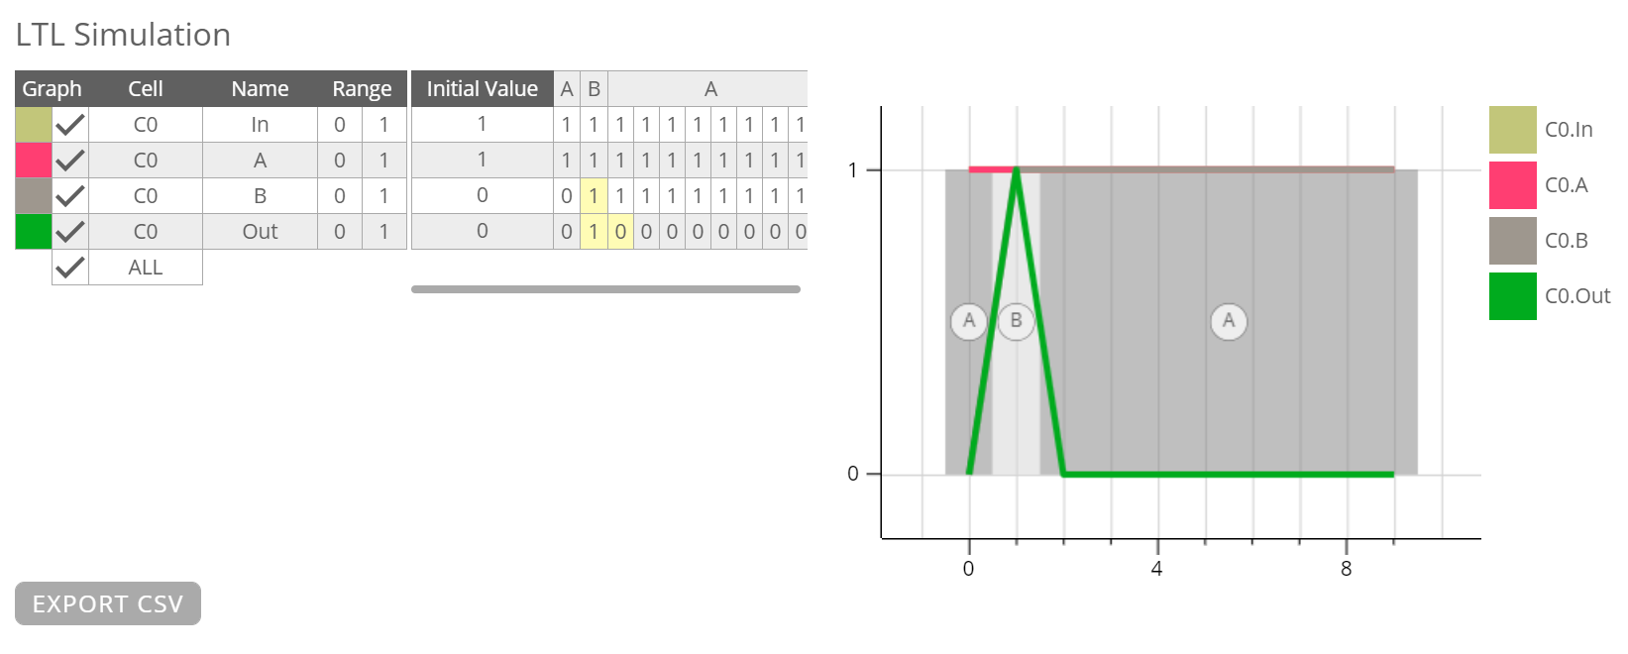
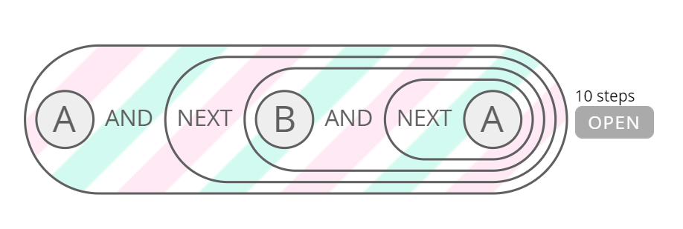
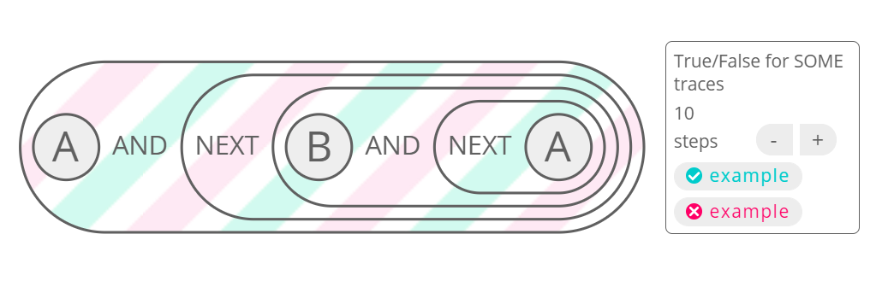
Visualising results

Slide 41
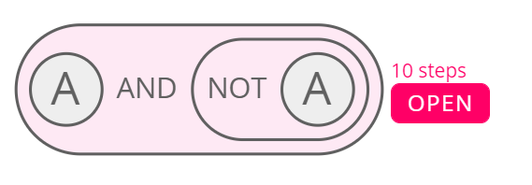
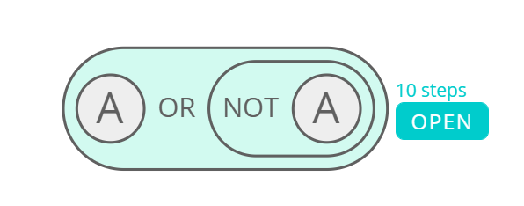
Paradox
Truth

Slide 42
Algorithm
Fundamental approach is a Z3 query
Encodes the both the LTL query, and the transitions
If this returns true, the query is negated and rerun
True/True – Sometimes
False/True – Never
True/False – Always
To reduce state space for searching, a variant of the range-tightening is used

Slide 44
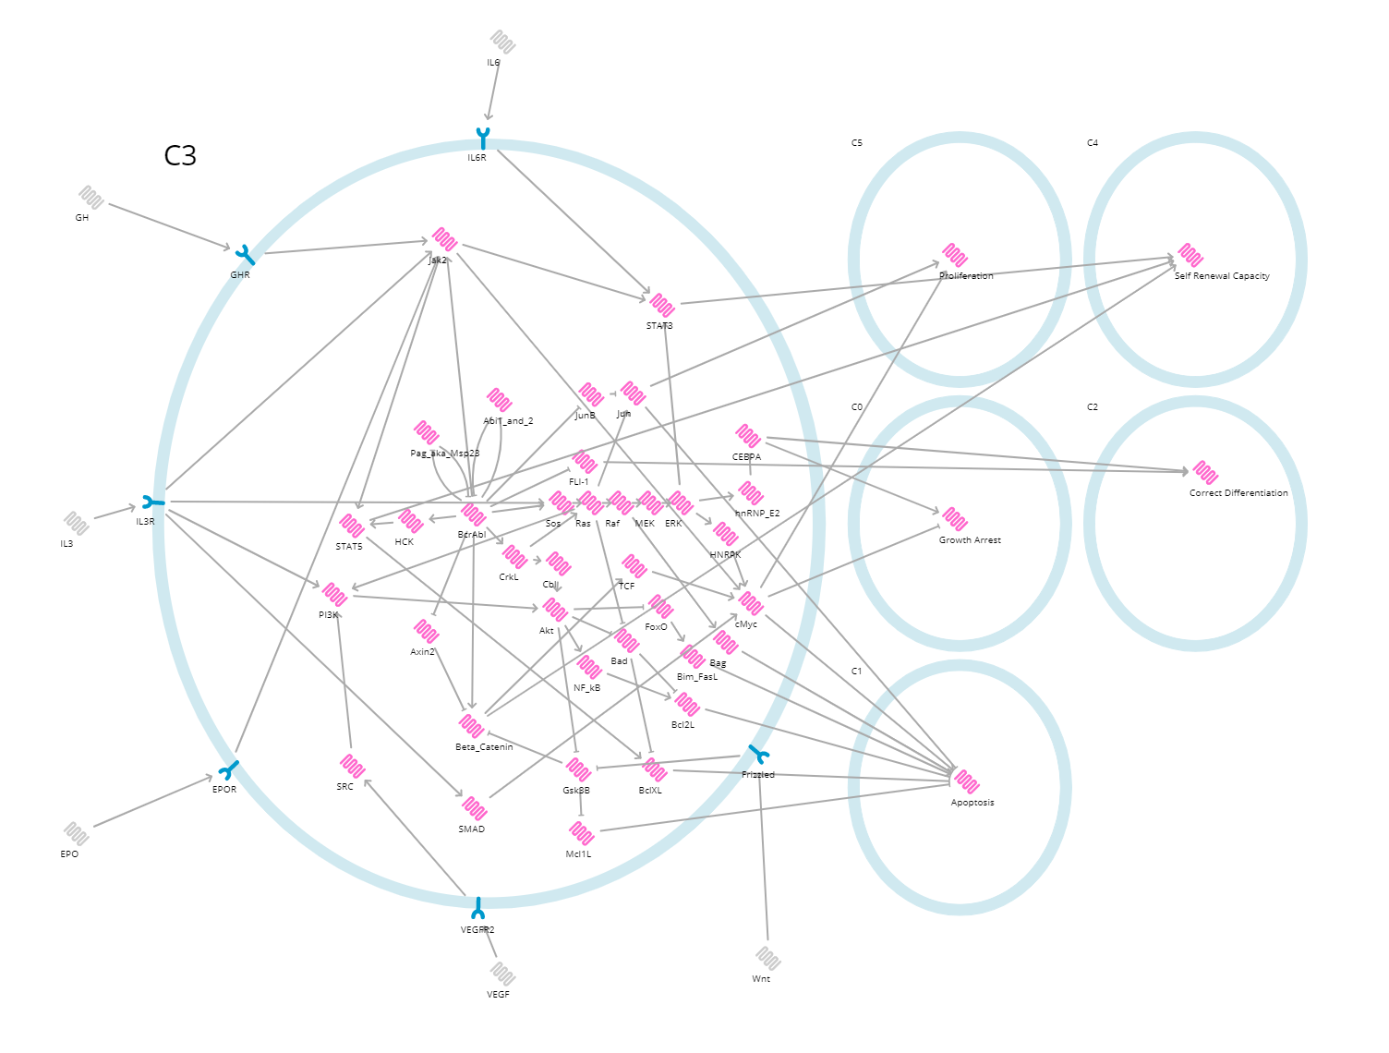
Scalability
~3^50 states

Slide 45
Other model checking
Console tool offers options for model checking not integrated into UI
Attractors
Asynchronous stability counter example search (Clarke et al, ARSBM 2019)
Pathfinder
Stability when constants change (environment switching) (Hall et al, Biophysical Journal, 2015)
SCM
Stability proof variant with faster cycle search (Cook et al, CAV 2014)
Console tool also can be scripted, run for longer

Slide 47
Leukaemia
Model of CML, with transformation from chronic phase to blast crisis controlled by activity of Bcr-Abl
Cell-wide knockout screens with stability testing to explore potential drug combinations
Chuang et al, Scientific Reports 2015

Slide 48
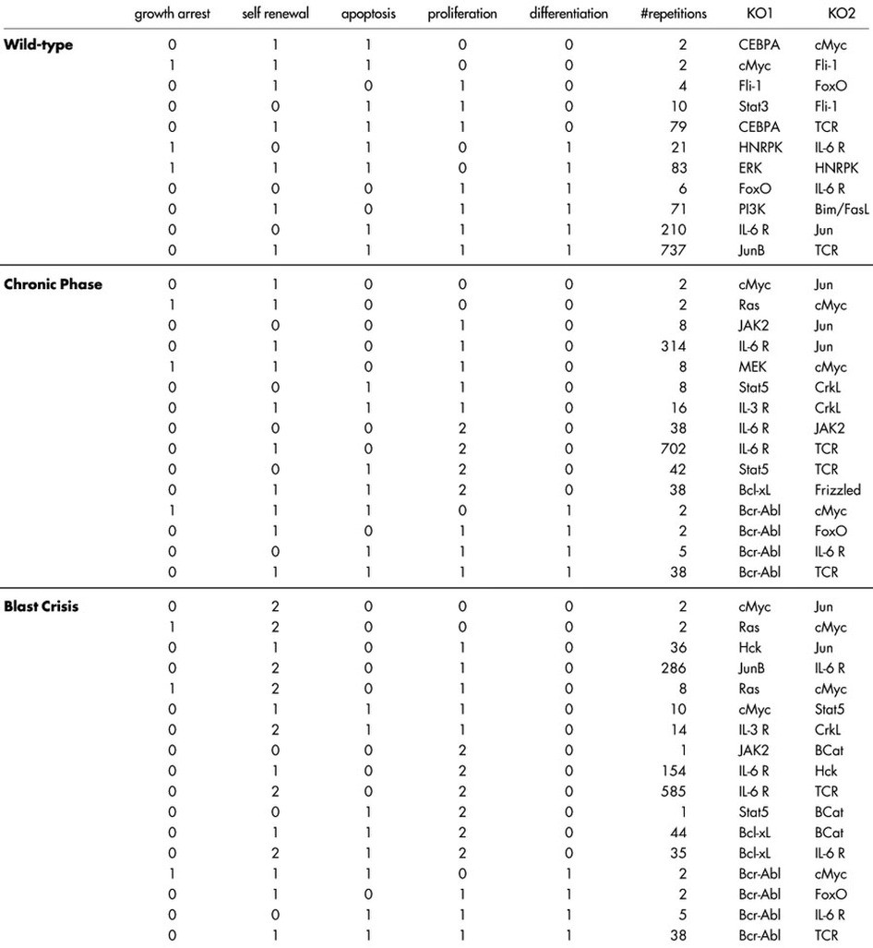

Slide 49
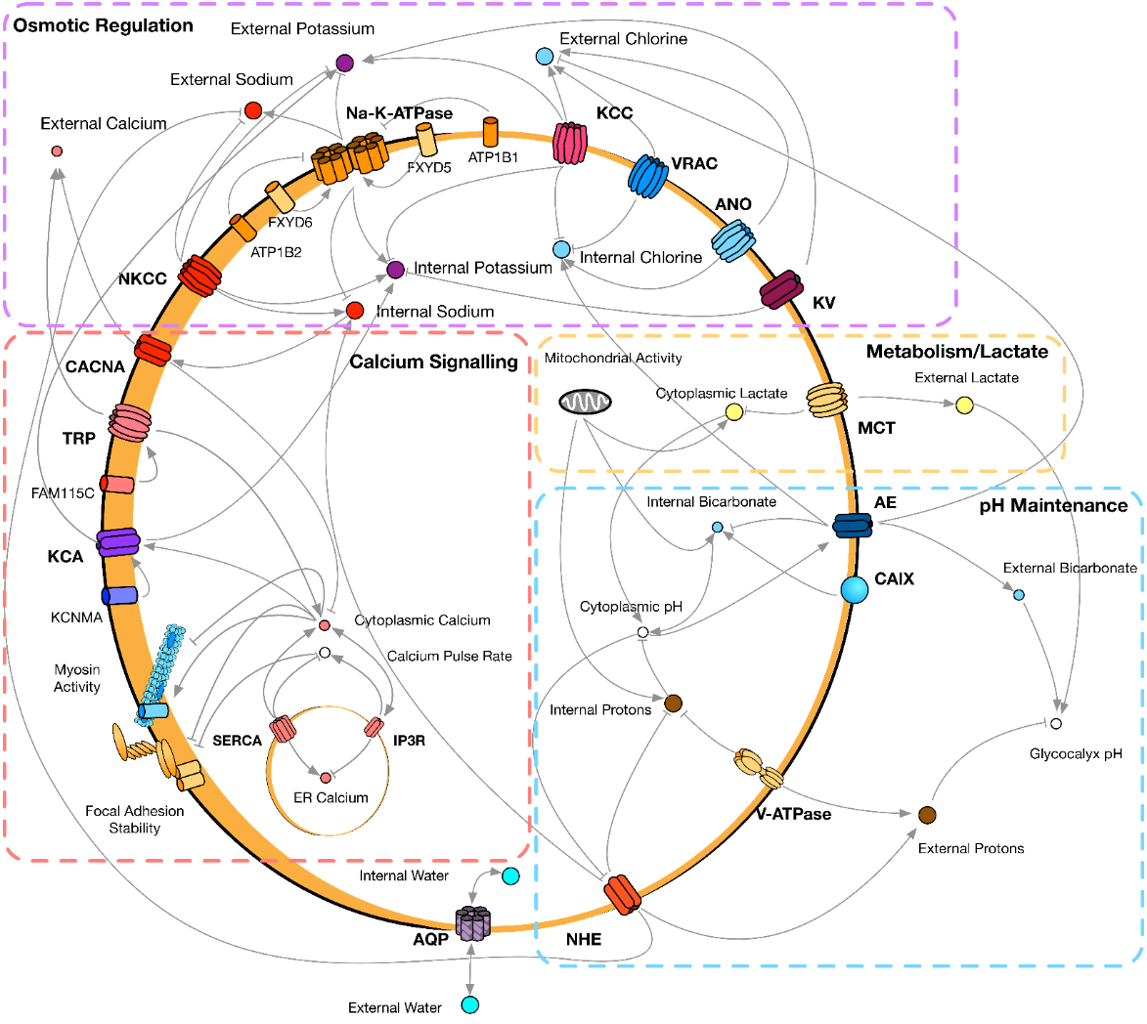
Ion channel networks
Guided by microarray data, network constructed from the literature
Predicts effects of drugging and synergistic combinations; validated in culture
Shorthouse et al, Nature Communications 2018

Slide 50
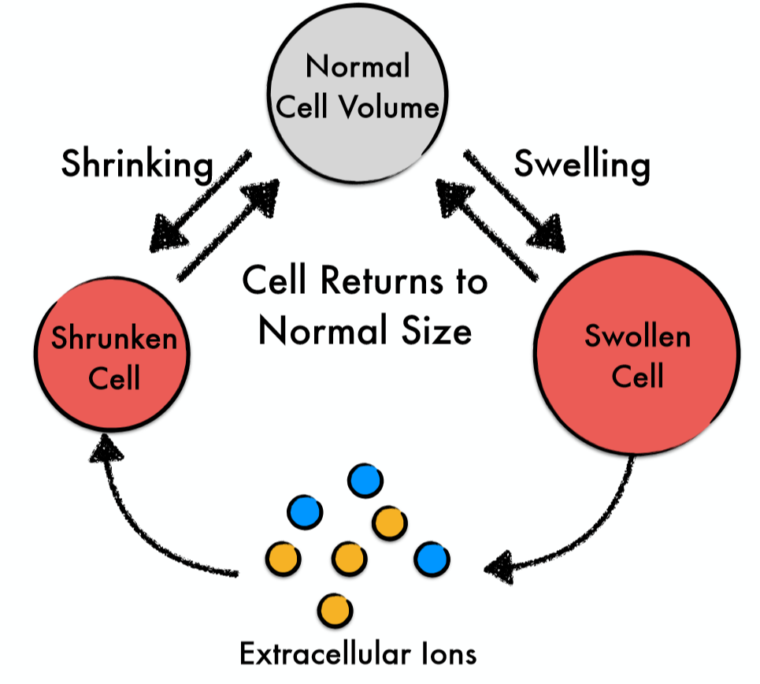
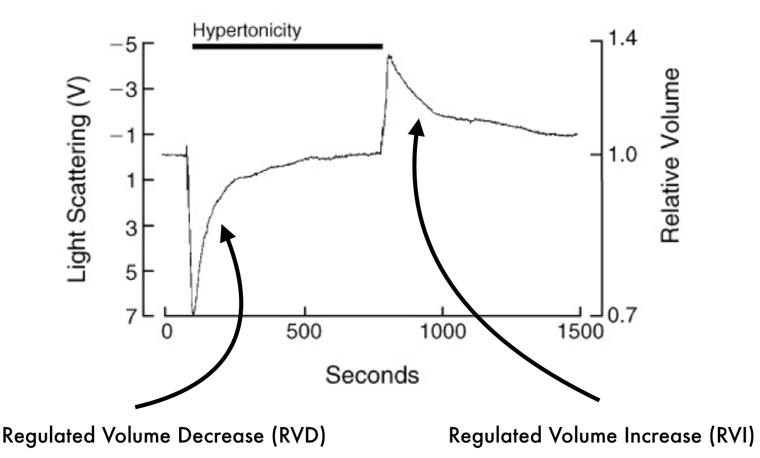

Slide 51
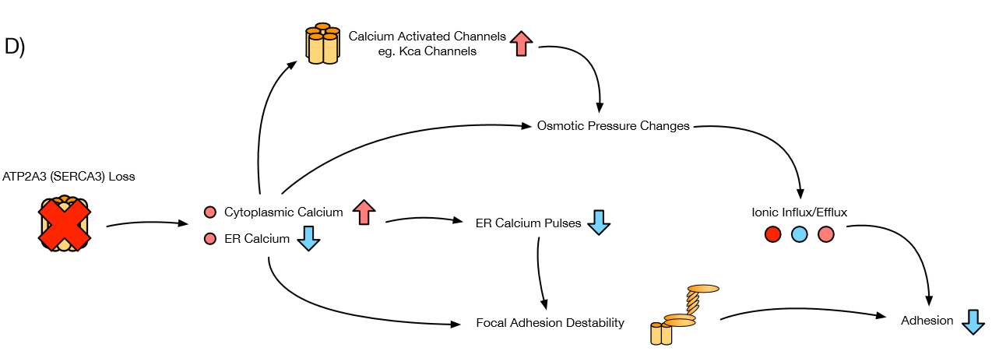

Slide 54
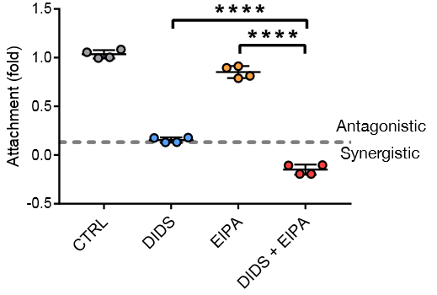

Slide 55
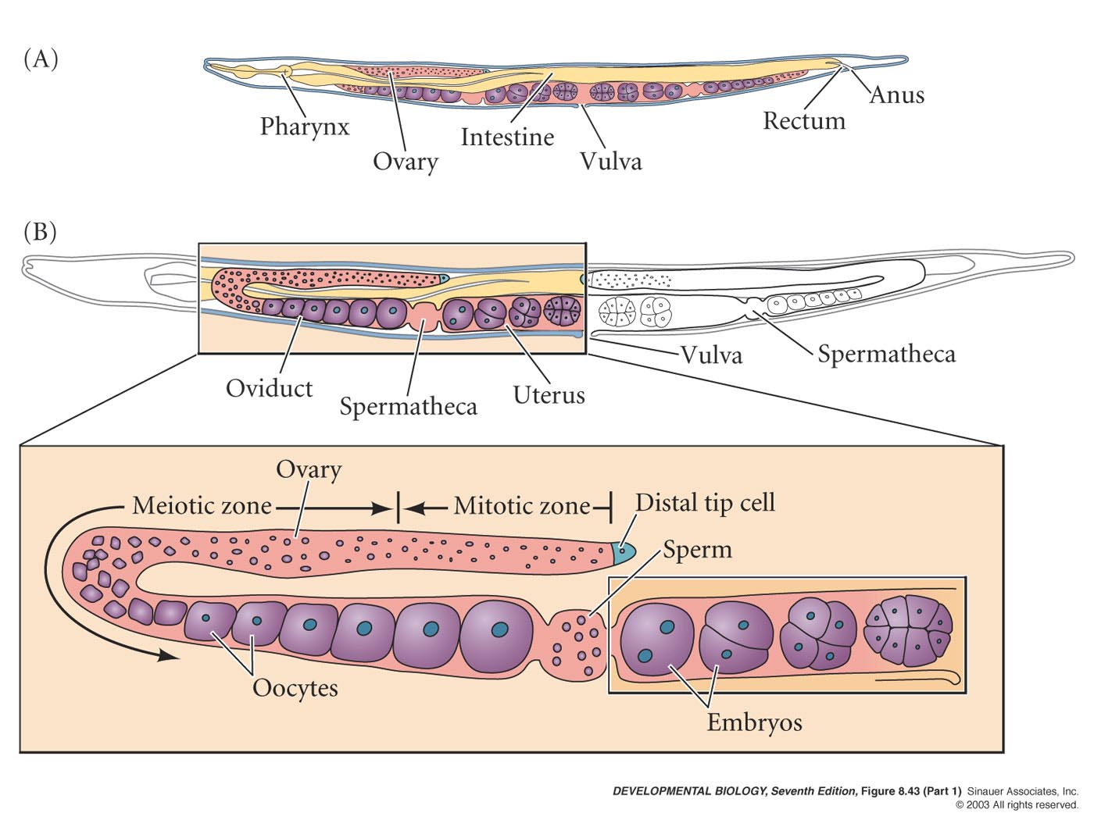
Organ development
Hall et al, Biophysical Journal 2015

Slide 56
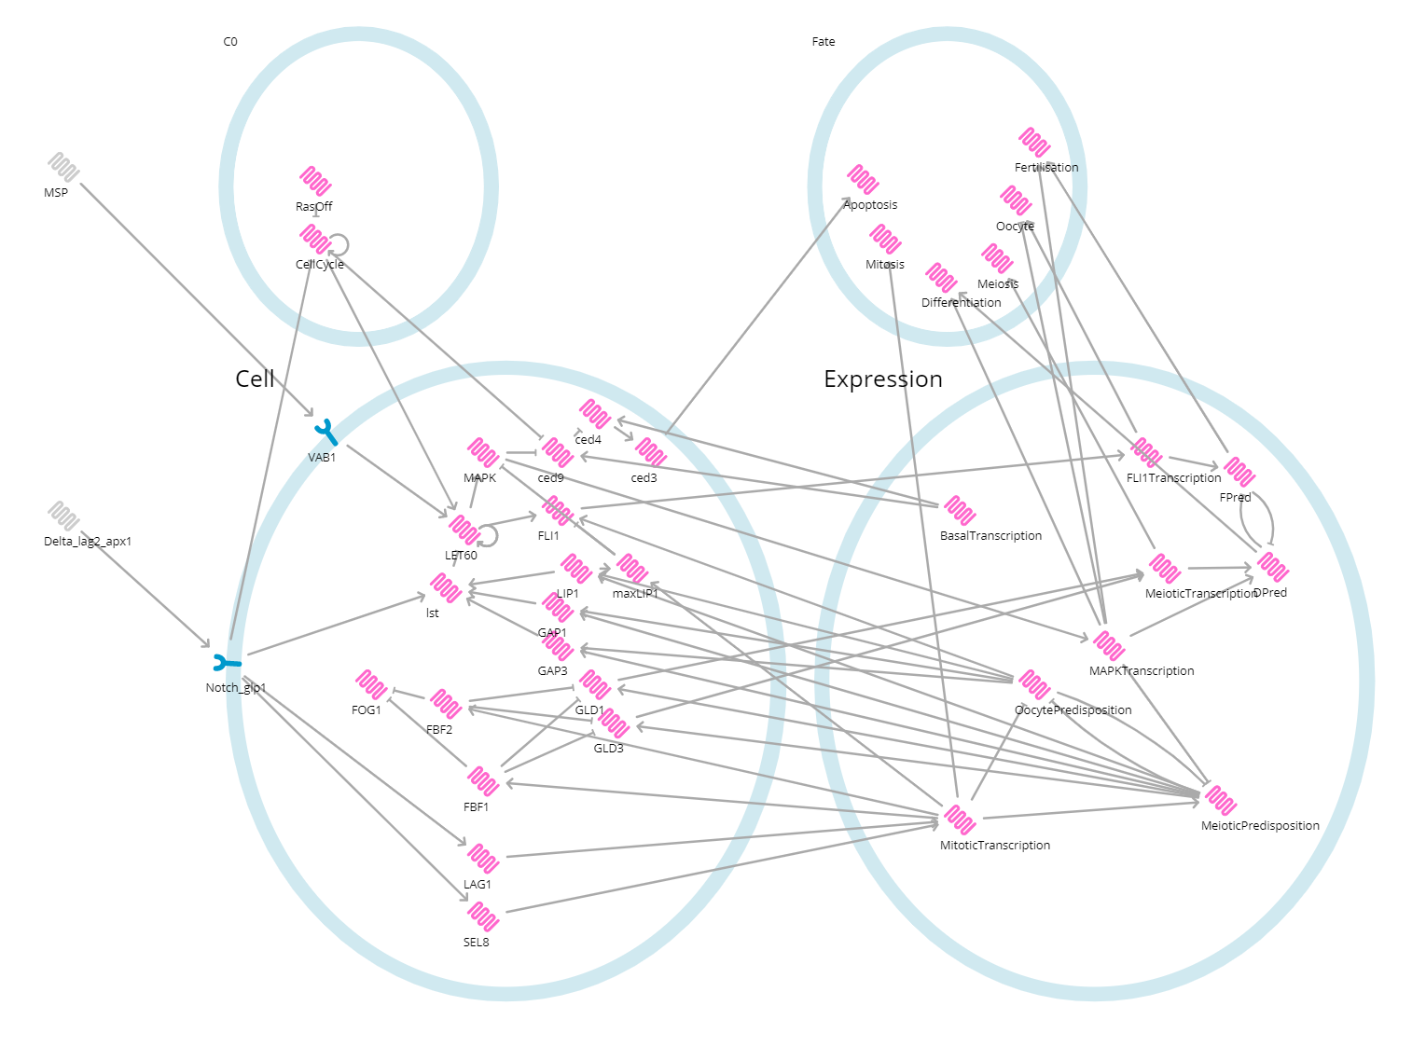
Hybrid simulation

Slide 59
Tracking cell fates
Red cells are mitotic, yellow meiotic, green differentiating and blue developing into oocytes
The pattern of fates is invariant

Slide 60
Fate progressions; a new abstraction
Mitosis
Meiosis
Differentiation
Oocyte
Wild type

Slide 61
Fate progressions of common mutants
Wild type
Notch GF
Ras GF
GAP1 KO
GAP3 KO
GAP1/GAP3 KO

Slide 62
Invariance through islands of stability
Original → all states were stable
Now → only needs to be stable in the first environment
this stability restricts progression to give the invariant pattern
Explored through stability proofs
Proved fate invariance in BMA Console Tool (Pathfinder)

Slide 64
Conclusions
Model checking is uniquely powerful for understanding biological systems
BMA offers scalable proof algorithms
These have been successfully to the study of a diverse set of systems

Slide 66
Practical session
Document covers two sessions
BMA
Covers using the UI, testing for stability and LTL, and some more advanced features
Z3
Basics of making SAT queries, run in jupyter notebooks
Pick one!

